Slide 1

Do Now
Two people were making a cup of coffee – Michael made his coffee by adding instant coffee to the water, then putting it in the microwave. Mark, horrified, instead added boiling water straight to the instant coffee.
Michael noticed that Mark’s beans instantly dissolved, whereas his only dissolved after the cup came out of the microwave.
In your books, identify:
One question you might want to test after learning this.
Your hypothesis that would accompany this question.
An experiment you could run to determine if your hypothesis is right or wrong.

Slide 2
Observation
Using our senses
Inference
What we think is happening
Independent Variable
What is purposefully changed
Dependent Variable
What is measured
Controlled Variable
What is kept the same

Slide 3
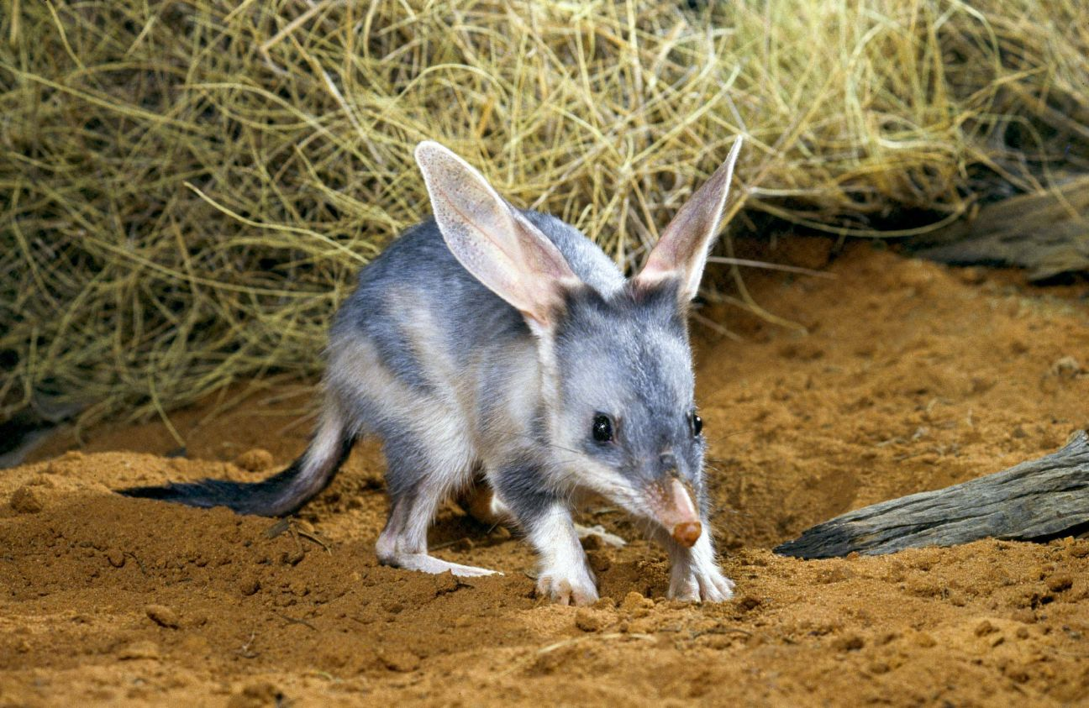
A group of scientists wanted to learn what a group of bilbies preferred to eat. Each day, they put out 3 different types of plant roots to see which plants the bilbies preferred to eat.
Name the independent variables
Name the dependent variable
Name three (3) controlled variables the scientists should consider

Slide 4
A group of scientists wanted to learn what a group of bilbies preferred to eat. Each day, they put out 3 different types of plant roots to see which plants the bilbies preferred to eat.
Name the independent variables
The different plant roots
Name the dependent variable
How much of each root was eaten
Name three (3) controlled variables the scientists should consider
When they fed the bilbies, how much food was served, how much water the bilbies drank, if the bilbies were stressed

Slide 5
Two students were interested in learning if coffee stays hotter for longer if you use a plastic cup or paper cup. For this experiment:
1. Identify the independent variable
2. Identify the dependent variable
3. Identify two controlled variables
4. Write a hypothesis

Slide 6
Two students were interested in learning if coffee stays hotter for longer if you use a plastic cup or paper cup. For this experiment:
Independent variable
The cup’s material
Dependent variable
The coffee temperature
Controlled variables
The coffee itself, the coffee’s environment, whether milk was added
Write a hypothesis
The coffee in the plastic cup will stay hotter for longer

Slide 7
Introduction to Forces
Success Criteria
Describe forces as a push, pull, or twist
Explain that forces can cause an object to change its speed, direction, or shape
Describe a force in terms of its unit of measurement (newtons, N)

Slide 8

Describe forces as a push, pull, or twist
Think – Pair – Share
When you think of the word “force”, what pictures come to your mind?
Think about your answer quietly
When instructed, share with a partner
When asked, share with the class.

Slide 9
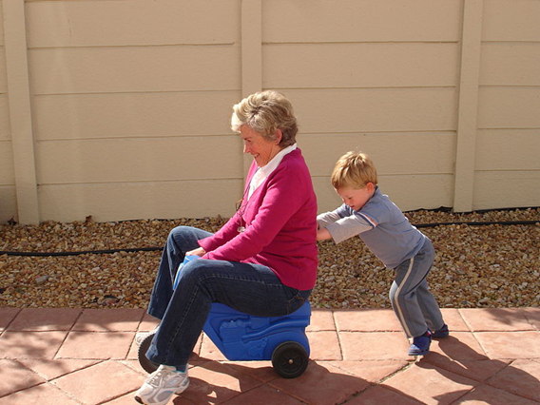
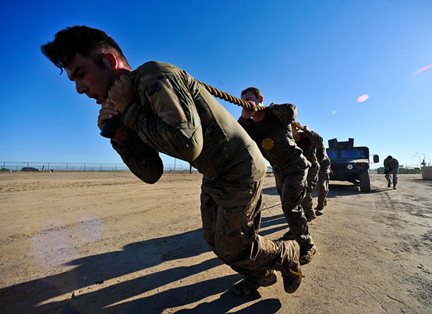
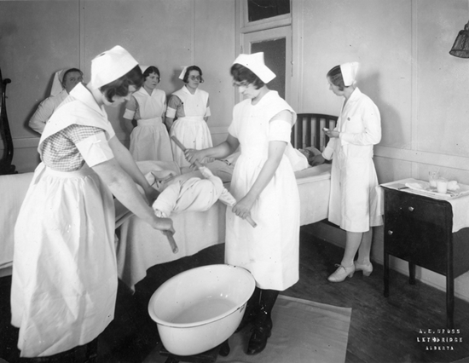
Describe forces as a push, pull, or twist
A force is something that an object does to another object to cause it to:
Speed up or slow down
Change shape
Change direction
A force typically looks like a push, a pull, or a twist
While we cannot see forces, we can see their effect on objects.

Slide 10
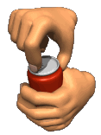
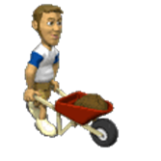
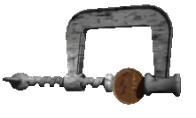
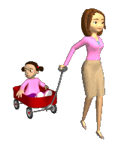
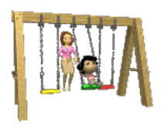
Describe forces as a push, pull, or twist
Which two images show the force push?
1
2
3
4
5

Slide 11
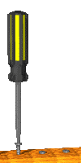
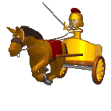
Describe forces as a push, pull, or twist
Which two images show the force pull?
1
2
3
4
5

Slide 12
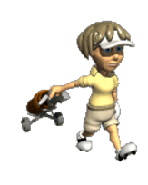
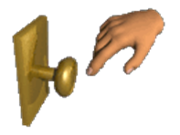
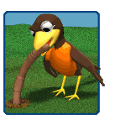
Describe forces as a push, pull, or twist
Which two images show the force twist?
1
2
3
4
5

Slide 13
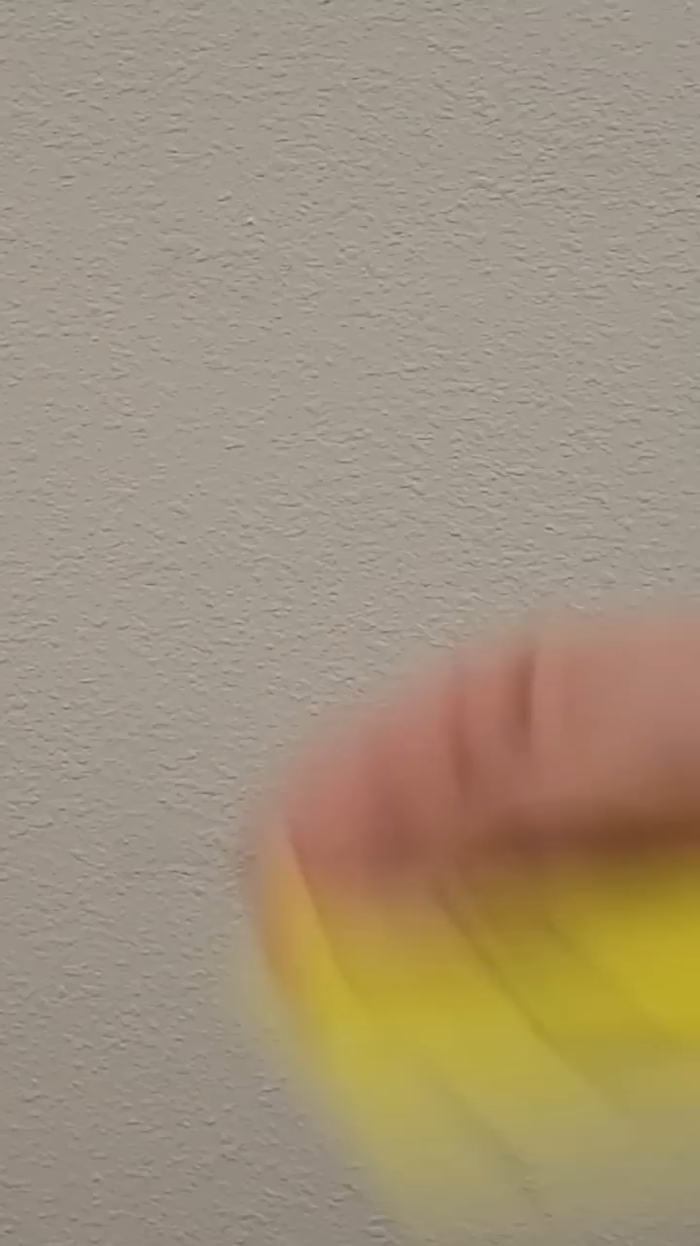
Brain Break
In this video, two of the facts shown are true, and the other is false. See if you can identify which is which before the end!
Notes:
https://www.youtube.com/shorts/G9Ol1PZk198 if video doesn’t work

Slide 14
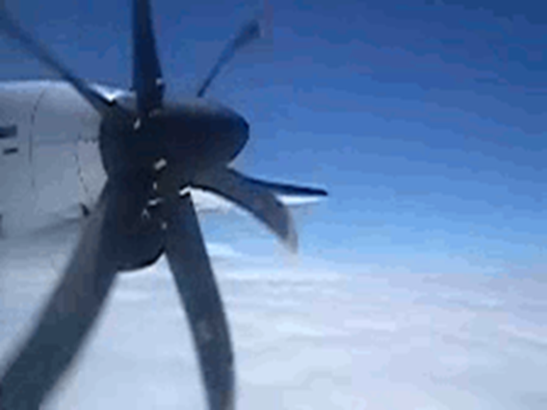

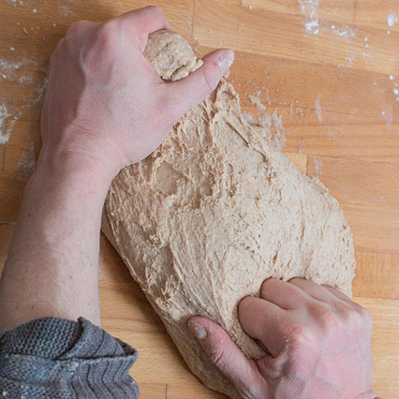
Explain that forces can cause an object to change its speed, direction, or shape
When an object experiences a force, it can do any of:
Get faster (accelerate)
Become slower (decelerate)
Change its direction
Change its shape

Slide 15
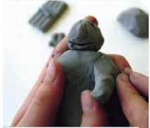
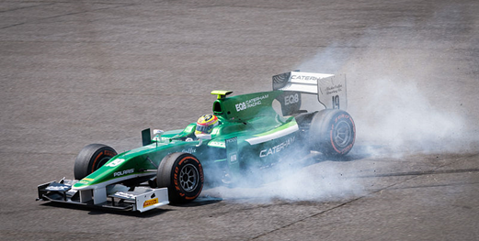
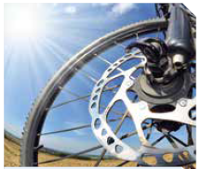
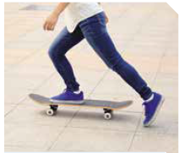
Explain that forces can cause an object to change its speed, direction, or shape
For each picture, describe what the force is doing.

Slide 16
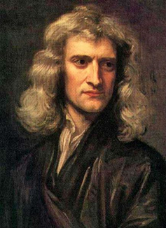
Describe a force in terms of its unit of measurement (newtons, N)
Units are measurements such as centimetres, minutes or kilograms.
In Science, forces are measured using a unit called a newton. The unit newton can be shortened to the letter N.
1 N of force is able to make 1 kg of stuff get faster by 1 m/s every second.

Slide 17
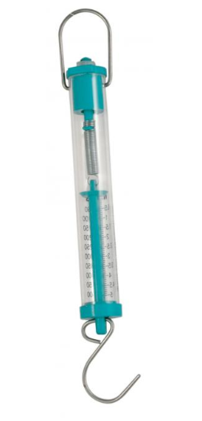
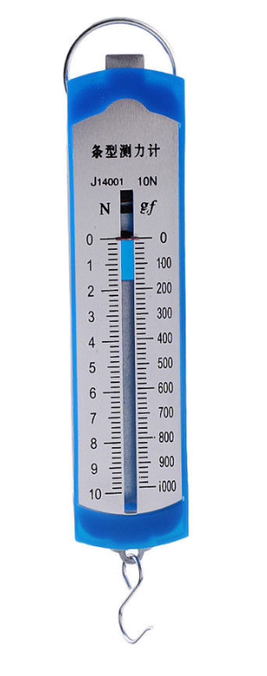
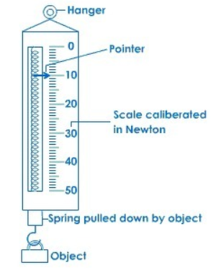
Describe a force in terms of its unit of measurement (newtons, N)
We can measure the amount of force by using a spring balance (sometimes called a newton meter).
There are many different designs, but they are all designed to work by measuring the weight force behind a pull.
Notes:
https://www.youtube.com/watch?v=NqdOyxJZj0U if video doesn’t work

Slide 18

Brain Break
In this video, two of the facts shown are true, and the other is false. See if you can identify which is which before the end!
Notes:
https://www.youtube.com/shorts/oYfceeXchgU if video doesn’t work

Slide 19
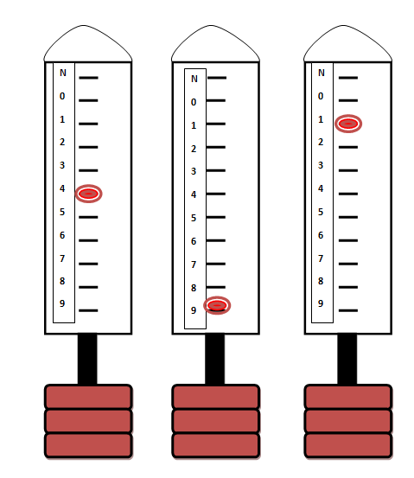
Explain that forces can cause an object to change its speed, direction, or shape
Answer the following questions in your book.
What is a force?
What is a newton?
What is the symbol for a newton?
True or false: Pulling an object can be measured in newtons?
How much force is being exerted on each of these spring balances?

Slide 20
Introduction to Forces
A force is something that an object does to another object to cause it to:
Speed up (accelerate)
Slow down (decelerate)
Change shape
Change direction
A force typically looks like a push, a pull, or a twist
While we cannot see forces, we can see their effect on objects.
Forces are measured using newtons (N).

Slide 21
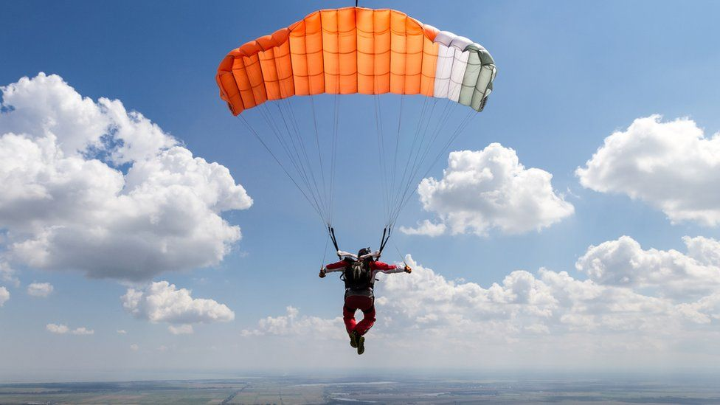
Introduction to Forces
We use forces every day in our lives – to pick things up, to run, to throw things, etc.
Some things we want to do are often too difficult (e.g., jumping from really high). By understanding the forces at play and how we can manipulate those forces, we can make seemingly very difficult things much easier to do.

Slide 22
Introduction to Forces
Success Criteria
Describe forces as a push, pull, or twist
Explain that forces can cause an object to change its speed, direction, or shape
Describe a force in terms of its unit of measurement (newtons, N)

